Slide 1
Imbali yabantu,imbaliso nolwandlao-ntetha malunga neNduli

Slide 2
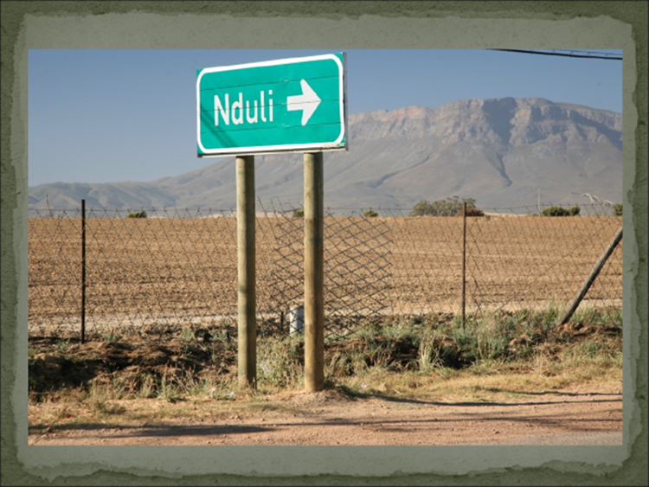
Imbali Yasenduli
Abantu(abamnyama) bokuqala eCeres
Imithetho yocalucalulo
eSakkiesbaai
Ukukhutshwa ngetshova
Ukuqala kweNduli

Slide 3
1920 – 1962
Abantu abamnyama abaninzi babesebenza kuLoliwe okanye kwiBhunga
Umhlaba wanikwa iBhunga ukuba lihlalise abasebenzi balo.Yabakukuqala kweSakkiesbaai oko.
Abantu bahlala eSakkiesbaai ukuya kuthi-gaa kunyaka ka 1962
Abantu bafuduswa kweyeKhala ngonyaka ka1962 ukuya eNduli

Slide 4
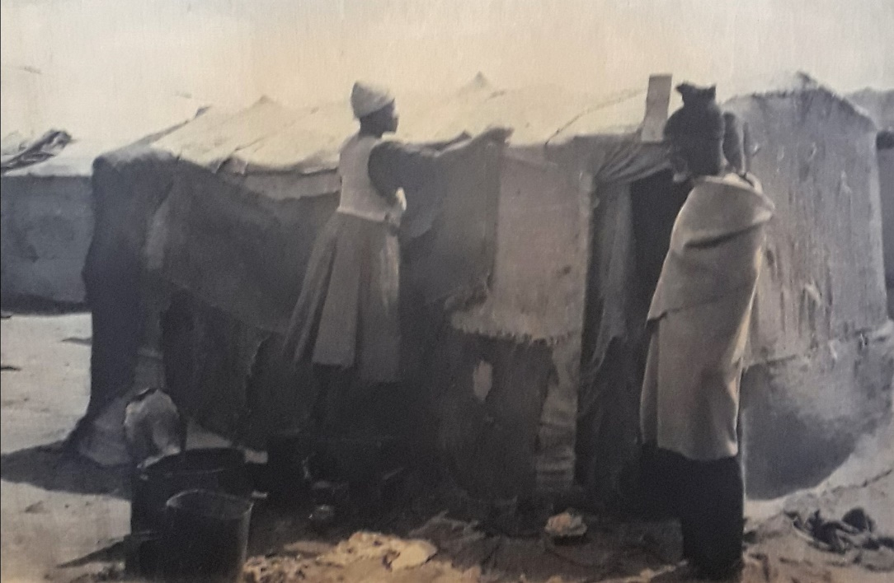
SAKKIESBAAI /Emasakeni
Eligama lithi eMasakeni libhekiselele kwizinto ezazisetyenziswa ukwakha amatyotyombe lawo babehlala kuwo ntlandlolo.

Slide 5
SAKKIESBAAI /Emasakeni
Ngo 1946 kwakunabantu abali195 kodwa ngo1951 elinani lalisele liphindaphindene.
kwekaCanzibe ngo 1946 umntu wayehlawuliswa i £3xa ethe wagxumeka isakhiwo ngokungekho semthethweni . Ngokwabanye abahlali zazikhona izindlu zeziTena kulengingqi. Ibishicilelwe kwimizuzu yonyaka ka 1940 kweyeDwarha ngomhla we14 ukuba”babevunyelwa abantu ukuba bokhe izindlu zeziTena”.
iMasakeni yabizwa ngokuba yiKampi yezingxamisekileyo ngo1952 .

Slide 6
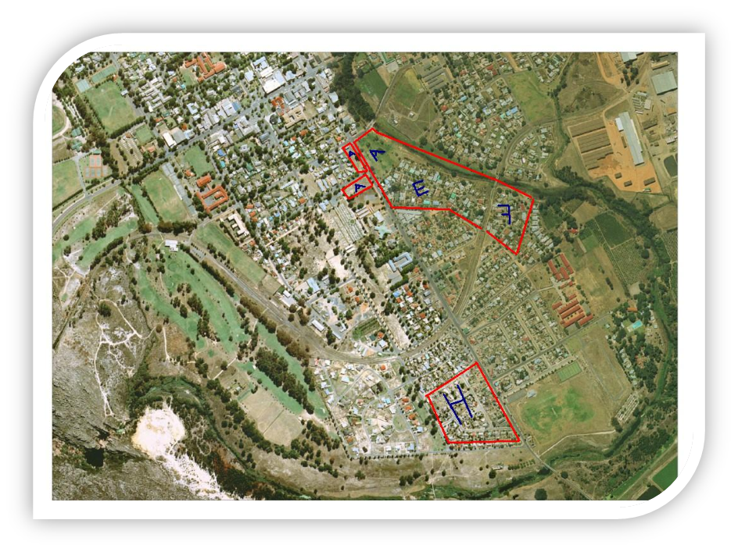
SAKKIESBAAI /Emasakeni
iMasakeni yayakhiwe kwindawo ebizwa ngeWhite City.
(H)Ngapha komzila kaloliwe phambi komlambo.

Slide 7
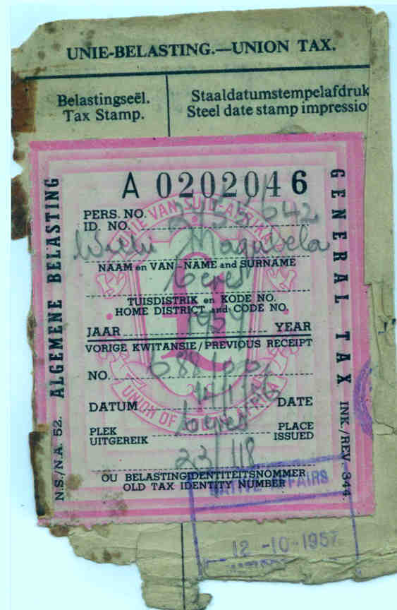
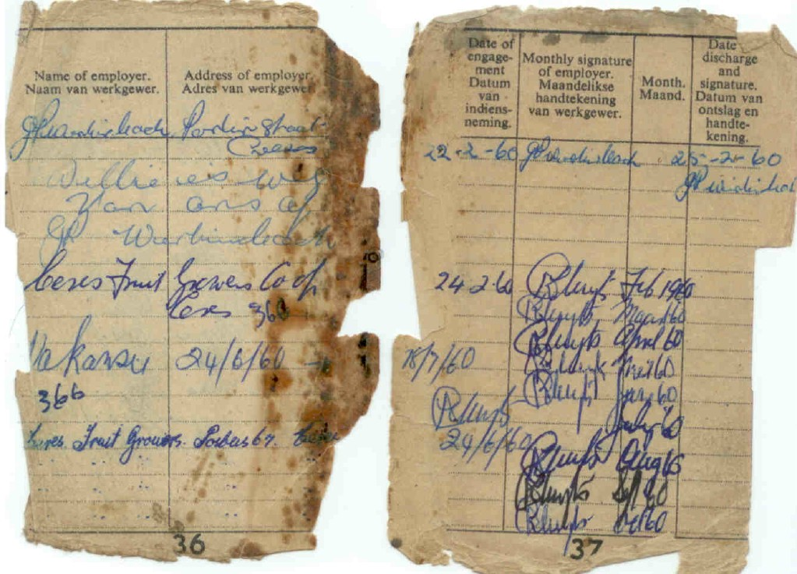
Pass Book

Slide 8
Umthetho 67 ka 1952
Wawusaziwa njengomthetho kaMapasi,lo mthetho wawunyanzelisa abantu abamnyama ukuba baphathe aMapasi imihla ngemihla. Ipasi laliqulethe umfanekiso,inkcukacha zendawo osuka kuyo,inkcukacha zengqesho,inkcukacha zeRhafu kunye nokuhlangene nesiPolisa. Ibikukophula umthetho xa ungaliphethanga iPasi lakho xa lifunwa ngaMapolisa. Akekho namnye umntu omnyama ebevumelekile ukuba ayokusebenza eDolophini ngaphandle kwemvume yabasemagunyeni.

Slide 9
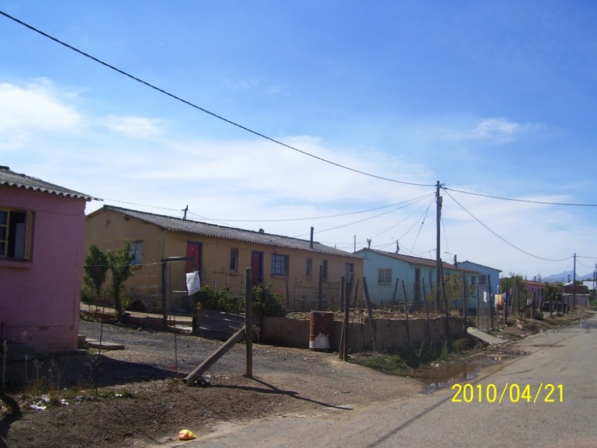
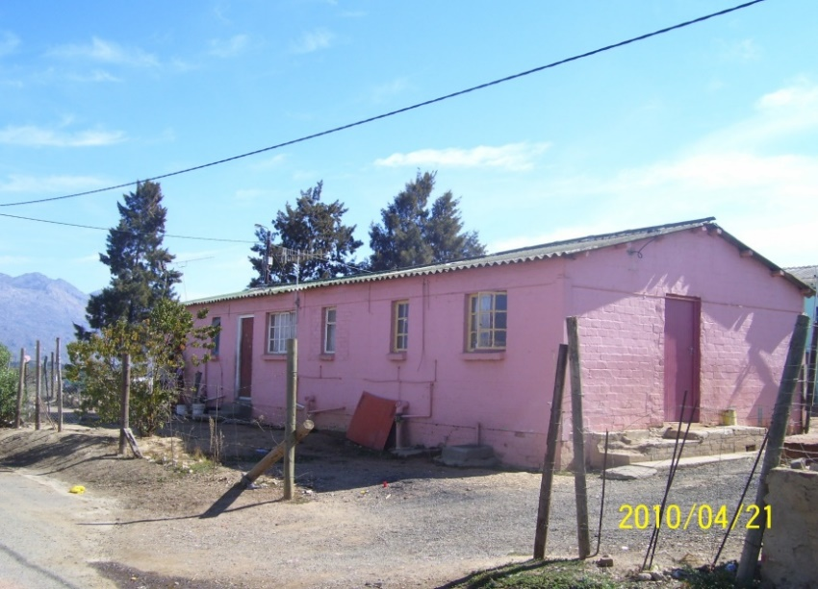
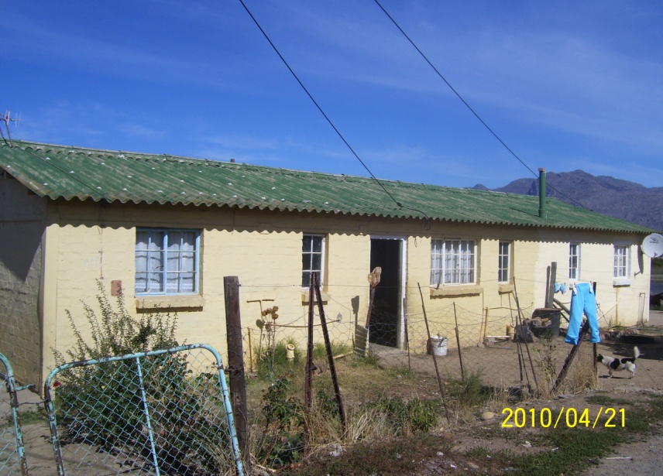
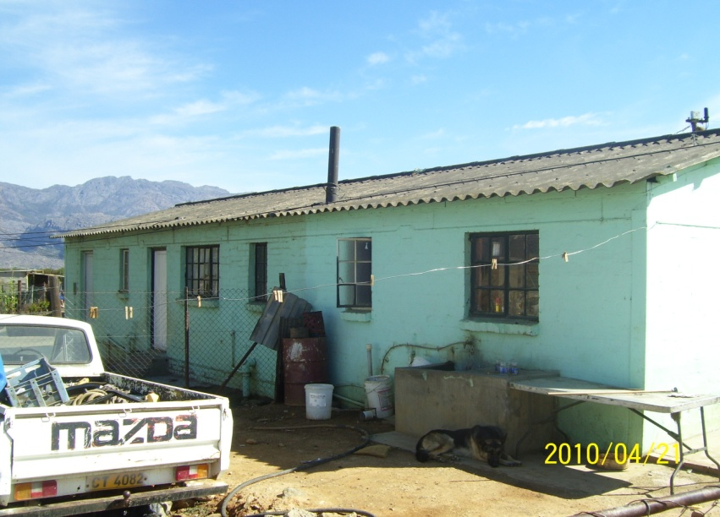
Ukuhlala Okokuqala kwabantu

Slide 10
Ukuhlala Okokuqala kwabantu
Eligama lithi nduli lithetha endulini (umhlaba oyinduli).
Abantu bakhutshwa ngetshova ngomhla wesi 21 kweyekhala ngo 1962. Amasoka namankazana.
Imaholo abantu ababini ayembalwa, kukho awokuhlala umntu omnye.

Slide 11
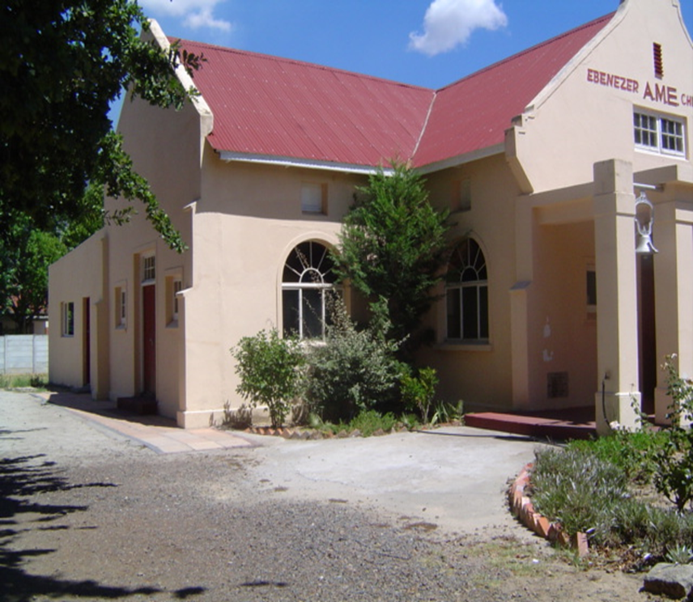
ISIKOLO SOKUQALA
Isikolo sokuqala sabantu abamnyama kwiCawe yaseEbenezer AME esisikolo sasihanjwa ngabantwana baseMasakeni.

Slide 12
Ngaphandle kwemimiselo nemigqaliselo kaRhulumente esisikolo saqhubeka ngokunceda abantwana abamnyama kunye nabeBala. Ngokwemizuzu yeBhunga yomhla wama 24 kweyoKwindla 1960 inani labantwana esikolweni lanyuka layakuthi ga kuma 43

Slide 13
ISIKOLO SOKUQALA NDULI S7

Slide 14
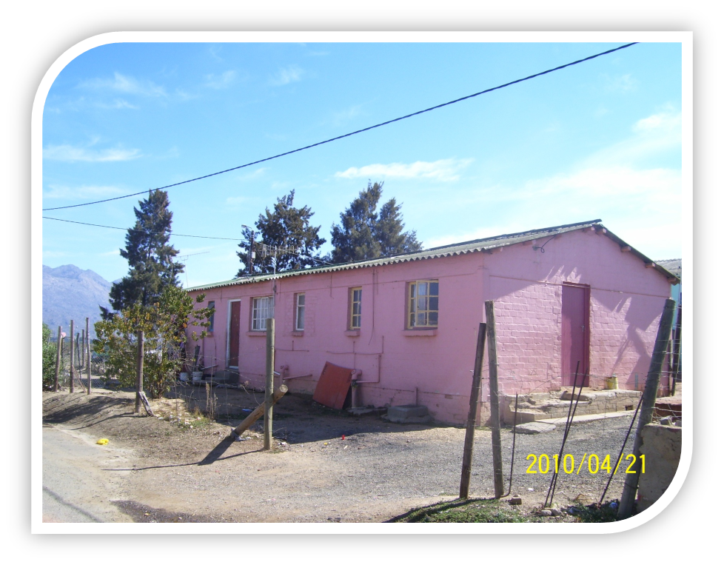
Ngelixa lukukhutshwa ngetshova uMnu Mbiko wayokuhlala kwa S7,ukuba abengumphathi-sikolo aze ahlale kwilinye igunjana kwakweliholo.Zonke eziklasi bezisabelana ngegumbi elinye ,kufundiswa amabanga ohlukileyo ngoTitshala abohlukeneyo. Abanye abafundisi-ntsapho babequka uMama uJane Sinoamali kunye noNkosk Nyangiwe.

Slide 15
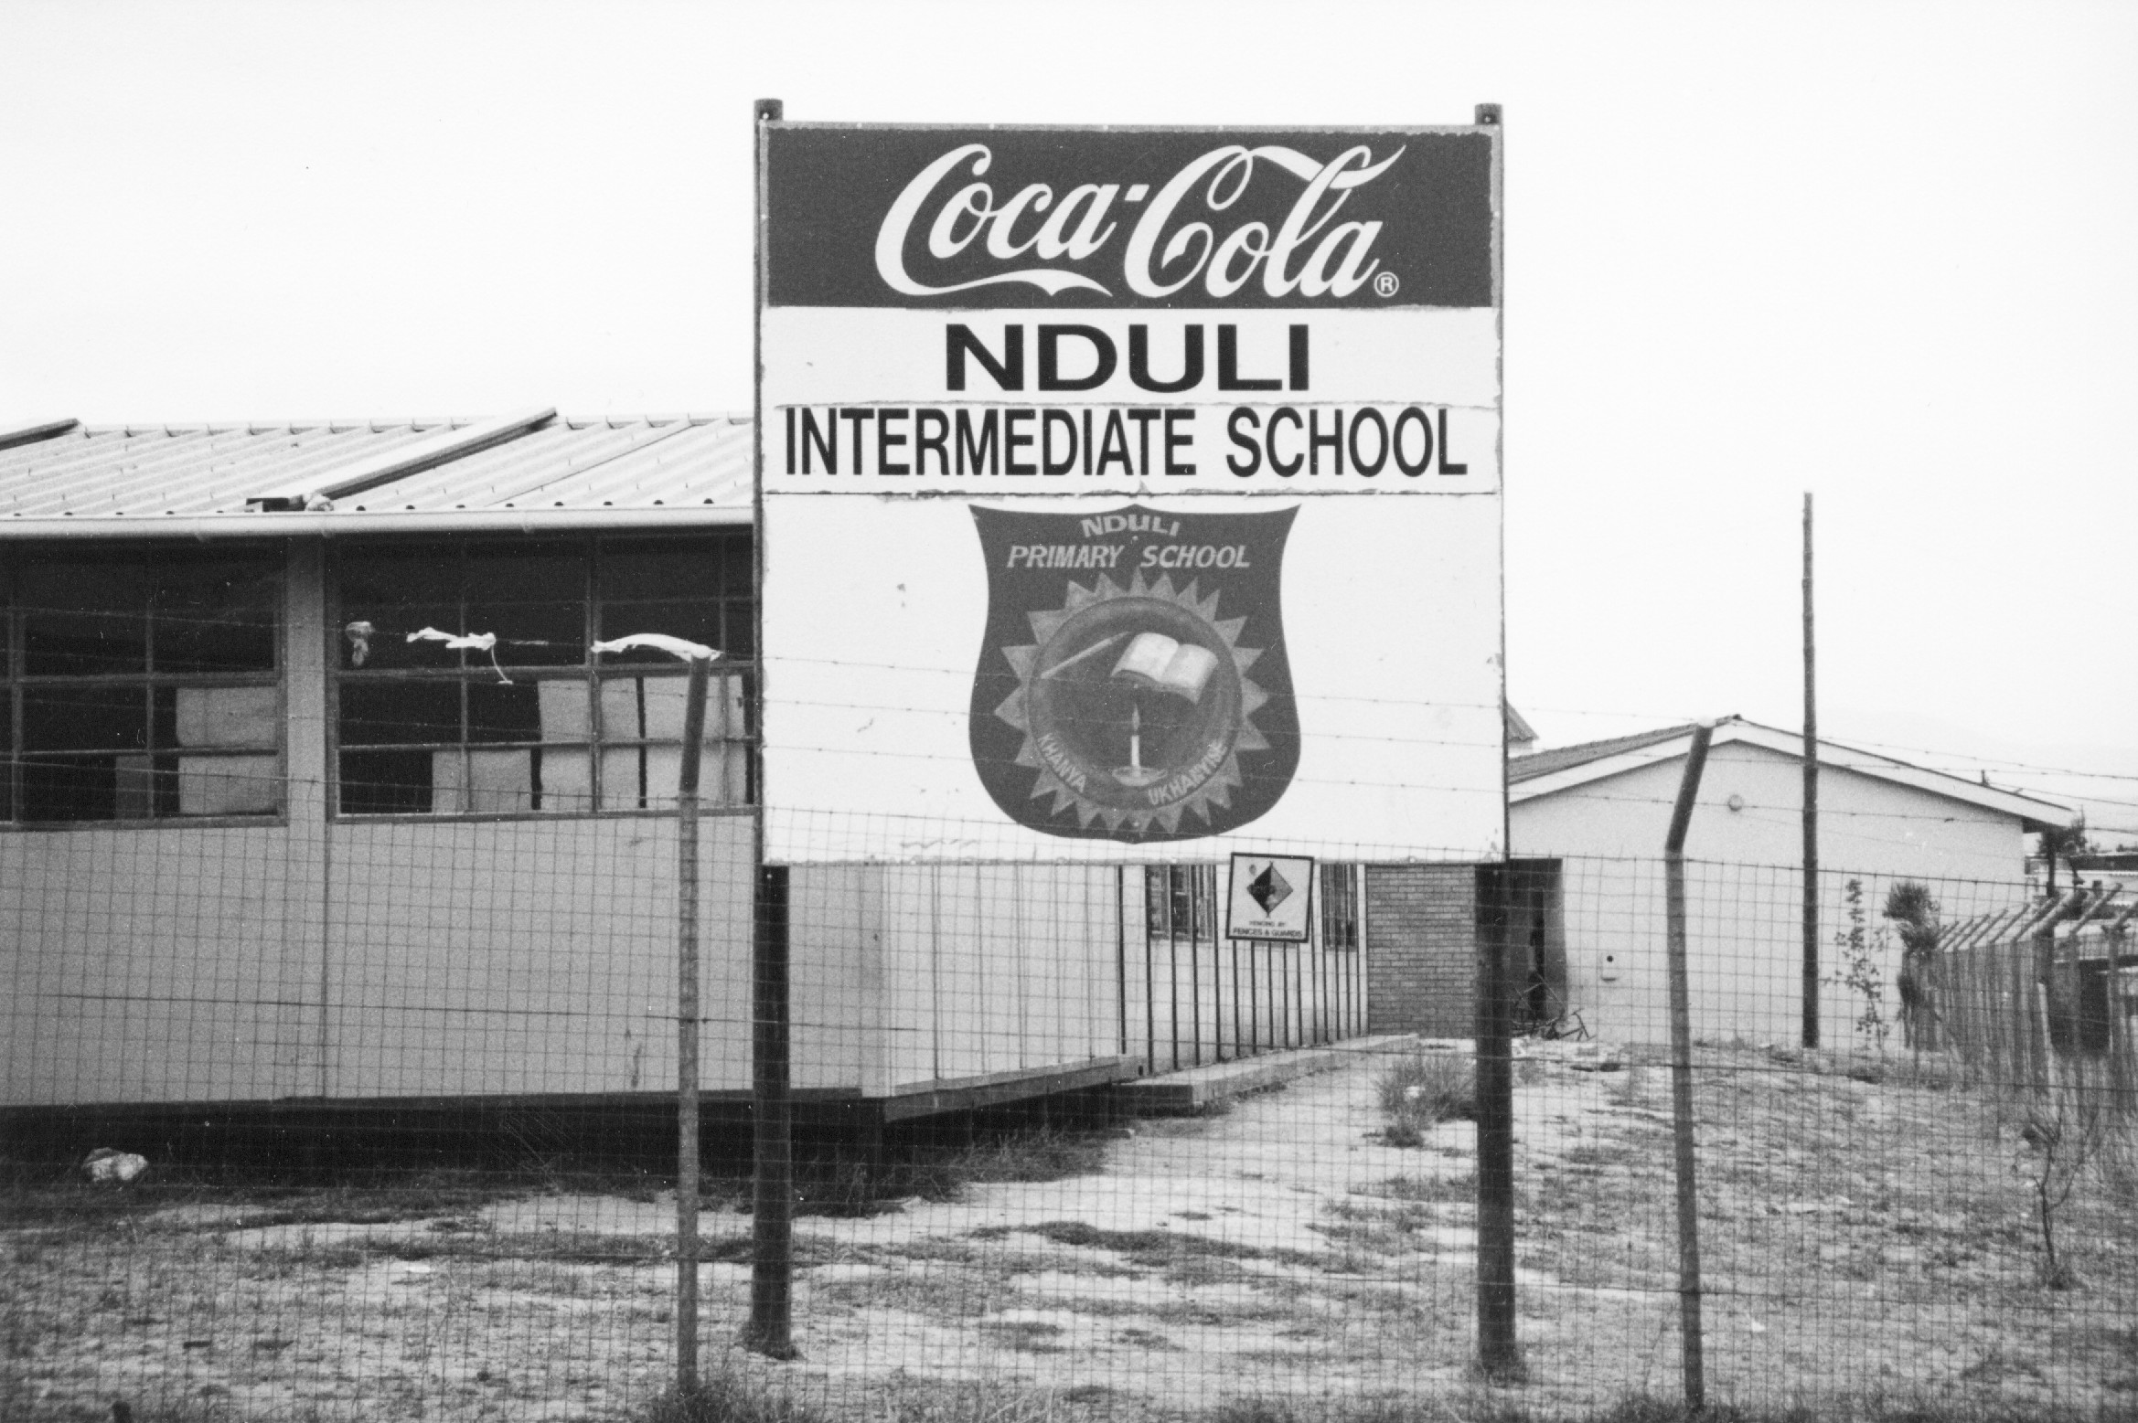
IMFUNDO YAMABANGA APHANTSI
KweyoKwindla ngo 1978 kwakhiwa isikolo yaliHolo elinye apho kumi khona isikolo saseNduli namhlanje, kwathi kongezwa elinye igumbi lokufundela ibanga lesihlanu(grade 7). Esisikolo sathi sathiywa igama elithi Nduli intermidiate.uNkosk. Nyangiwe wafundisa ithutyana elingephi kwesisikolo sitsha wade wathatha umhlala-phantsi kunyaka-mnye. Mnu. Vuyo Nqwemeshe wathi waqashwa njengeNqununu ngo1978,kwafakwa omnye uMfundi-ntsapho oyindoda uMnu Barnett Fula.

Slide 16
Teacher’s hostel

Slide 17
IINGCINGA ZETHU IMFUNDO YESINALA
Kwathi kongezwa iBanga lesi8 kunye nele9 ngo1991 ngenxa yokuba abafundi babenesidingo soku. Lamagumbi mathathu ayenzelwe ukuba kufunde lamabanga mabini elesi8&9. UNkosk Smith nguye awaxhuzula imikhala kulamagumbi mathathu.Lamagumbi athiywa ngokuba kuse(Learning center).Oku kwabangela ukuba kubekho amanenekazi alapha eCeres avolontiyayo. Isikolo i(Intermidiate) sasiqala kuSub-A ukuya kwibanga le7.I(Learning Centre)yatshintshwa yabayi-Iingcinga zethu S.S.

Slide 18
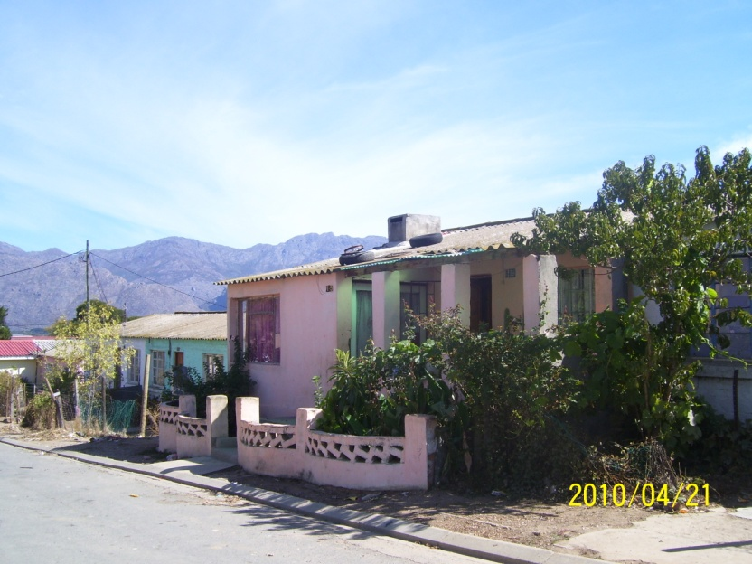
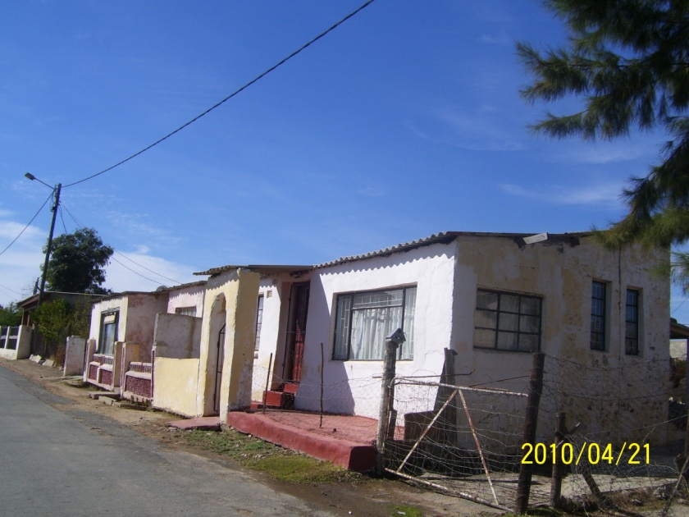
Isigaba sesibini sasebhongweni

Slide 19
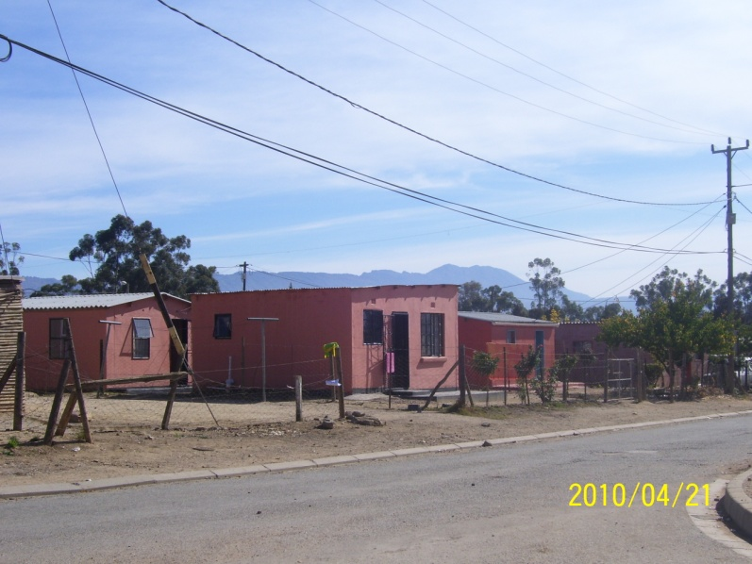
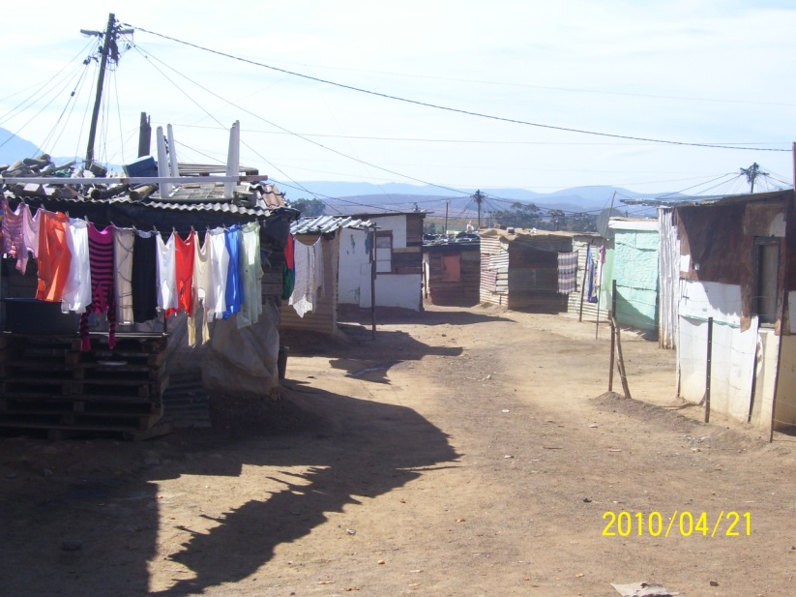
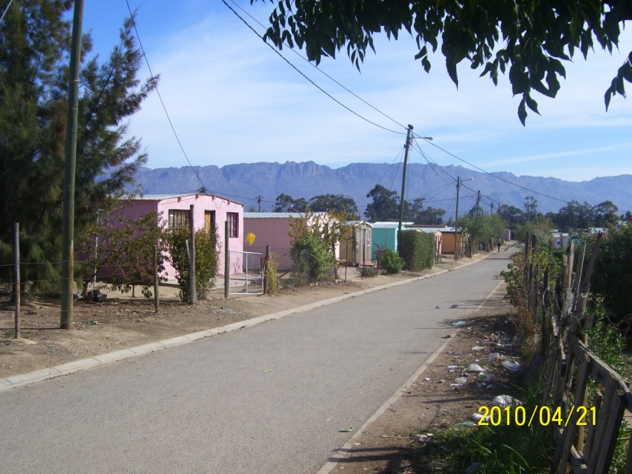
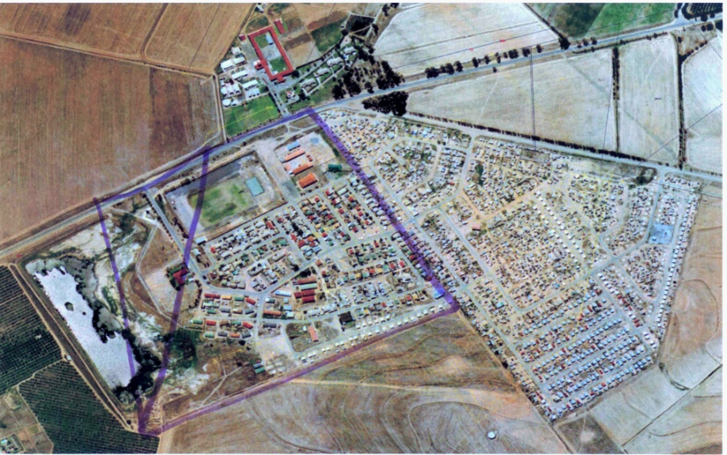
Polocross

Slide 20
First house in Polocross

Slide 21
Polocross
IPolocross yindawo yeMikhukhu eyokhiwa ngo1993,ngenxa yefuthe lomzabalazo kulwelwa utata uChris Hani “ngabantu”.
Imikhukhu isekhona phakathi kwezindlu kwaye ibizwa ngokuba kusesiGxum-gxumini,eli libinzana lesiXhosa elithetha imikhukhu egxunyekwe nje nanjanina.

Slide 22
Imikhukhu
Eluxolweni
Mooiblom
Mnandi
Nkonjane
Zibonele

Slide 23
Izindlu
Emaholweni
eZwelitsha
eBhongweni
eShukushukuma
eZone 14
ePollocross (RDP)

Slide 24
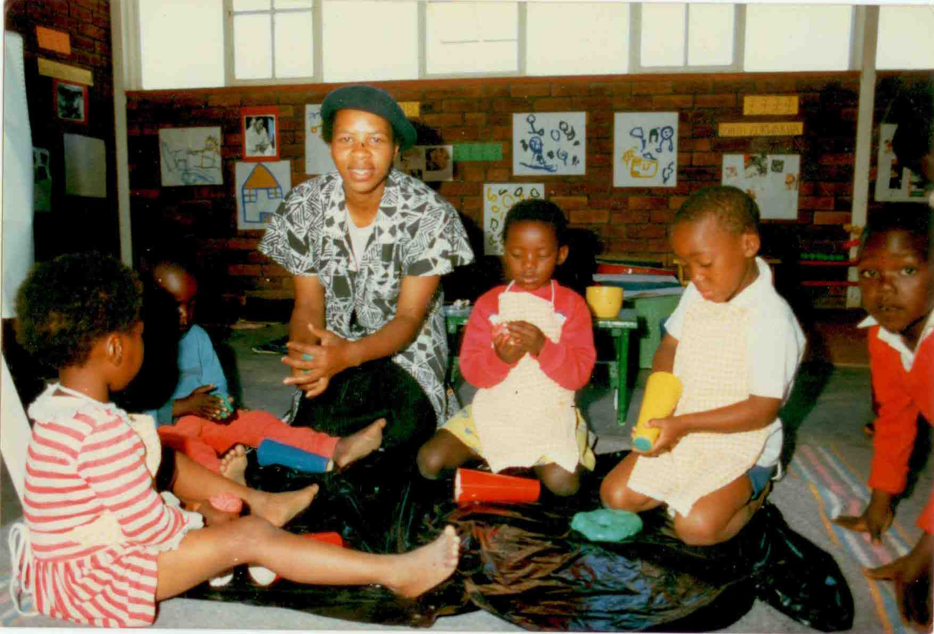
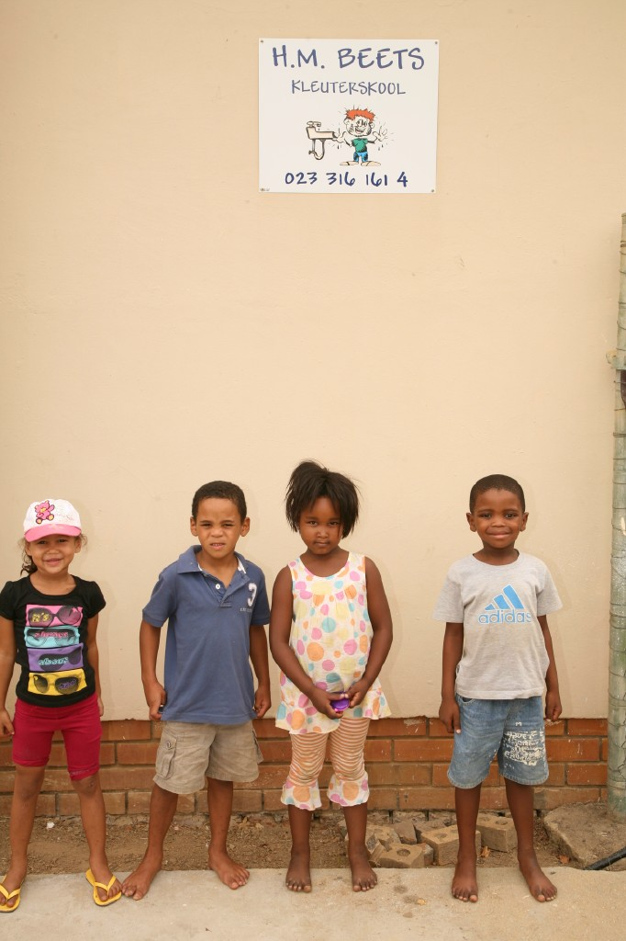
:“Kucace gca ukuba abantu abamnyama kunye nabebala bathi bahlangabezana nengxaki eziphathelene nocalu-calulo ngelixa localulo-calulo,izinto ezifana nokubekwa bucala,ukucalulana ngokwasekuhlaleni kunye nezopolitiko.Koko kubalulekile ukuba yonke imbali ishicilelwe nanjengoba sisazi ukuba ukumka kwabadala nemvelaphi yethu iyaduka ,oko kuthetha ukuthi abantwana bethu abasoze bazazi ukuba bavela phi?Xa ungazazi apho uvela khona ,phecelezi awuzazi apho uya khona,oku kuzakuvula umtyhi obekise ekubeni libemfiliba ikamva lethu ngokumandla. (Mzwakhe Njokweni))

